Slide 1
Journey PPT
Week 3

Slide 2
04-09-2023
Data Storage: Simple storage and Azure Data lake.
Benefits of Azure to store Data:
Automated Backup
Global Replication
Encryption Capabilities
Multiple Data Types
Support for Data Analytics
Storage Tiers
Virtual Disks

Slide 3
04-09-2023
Types of Data:
Hot Data: Accessed frequently
Cool Data: Accessed occasionally(60 days)
Archive Data: Accessed rarely(Available after storage account is setup)
On-prem vs Azure:
Azure is cost effective
Azure is more reliable
Azure provides variety of storage types
Azure provides flexibility to create services in minutes.

Slide 4
04-09-2023
Storage Account:
A container that groups a set of Azure Storage Services. Only data services can be included such as Azure Blobs, Azure Files, Azure Queues, Azure Tables
Number of storage accounts depends on data diversity, cost sensitivity and tolerance for management overhead.
Deleting storage account deletes all the data inside it

Slide 5
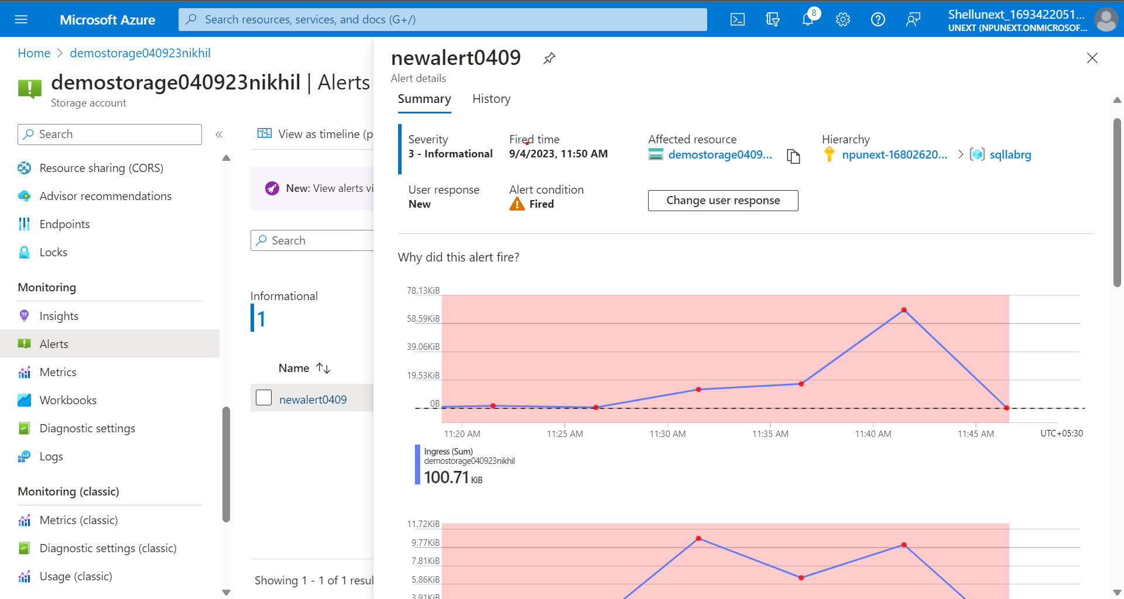

Slide 6
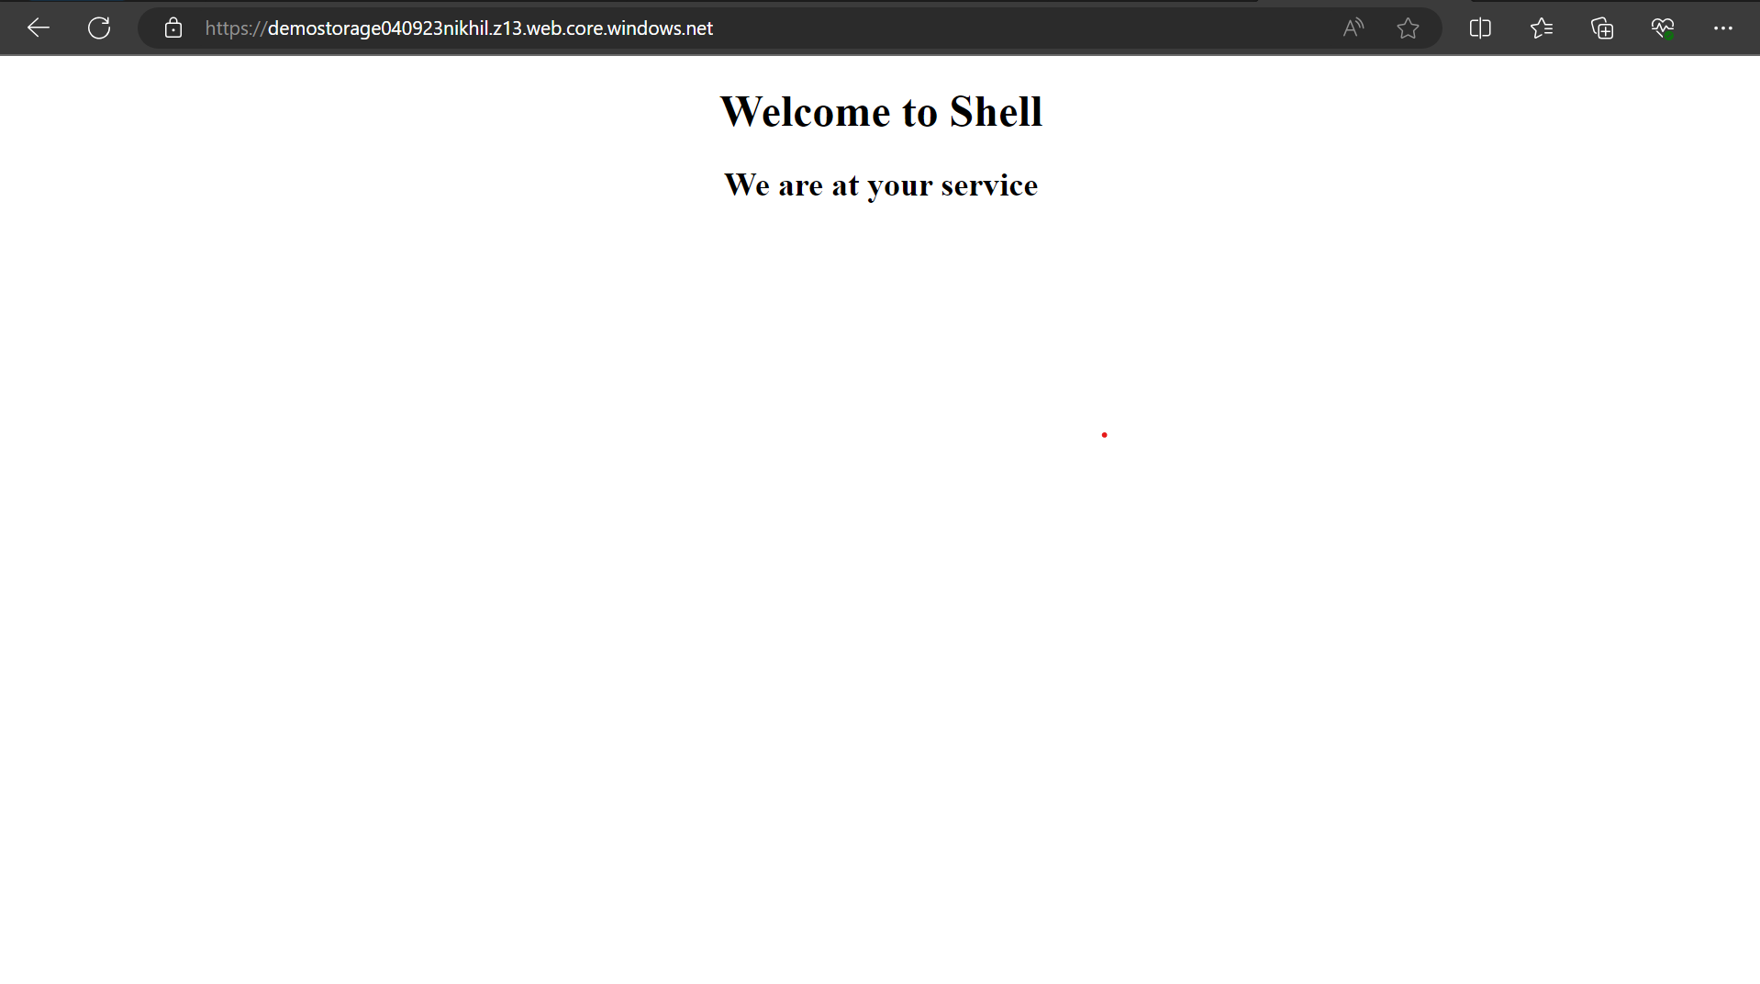

Slide 7
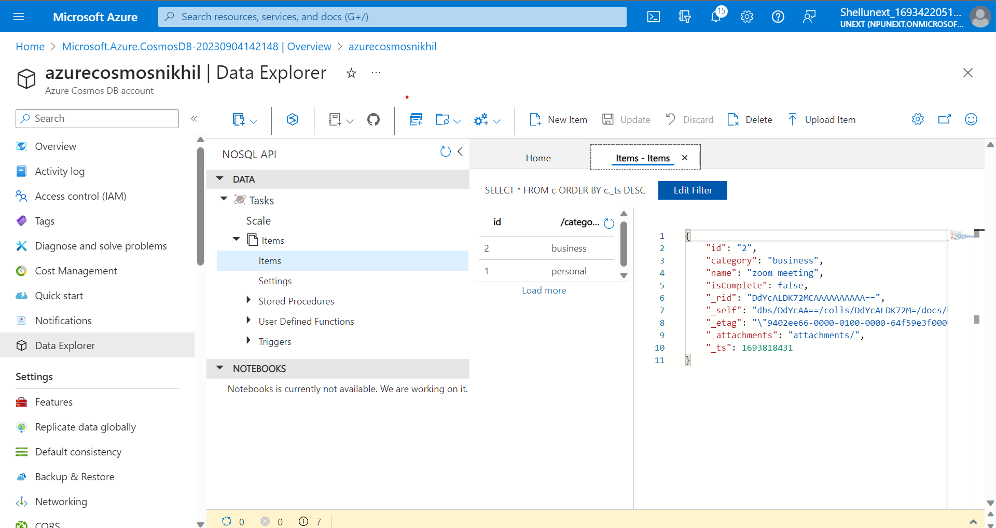

Slide 8
05-09-2023
Set database level firewall: exec sp_set_database_firewall_rule N’demorule’, @startipaddress = ‘0.0.0.0’, @endipaddress – ‘255.255.255.255’;

Slide 9
05-09-2023
ETL: Extract Transform Load
ELT: Extract Load Transform
Extraction can be from different sources e.g. csv, json, txt.
Transformation consists of cleaning, de duplication of data, custom calculations, conversion of data etc.
Load: Sink/destination/database like data warehouse
ELT takes less time than ETL
Transformation takes a lot of time.

Slide 10
05-09-2023
In ELT, loading of data is in its raw format. Transformation is done on demand.
Loading is done in Azure Data Lake storage.
Azure Data Factory is used for ELT.
ADF creates, orchestrates and automates the movement, transformation and/or analysis of data in the cloud.
ADF Process: Connect and collect -> Transform and Enrich -> Publish -> Monitor

Slide 11
05-09-2023
We need a link service to act as a connector to source or destination of data.
SQL server, Hadoop cluster, data lake storage, azure data bricks are examples of link service.
Activities are transformations.
Pipeline is combination of multiple transformation activities.
There can only be 40 activities in a pipeline.

Slide 12
05-09-2023
Auto Resolve Integration Runtime: Cloud to cloud
Self Hosted Integration Runtime: On-premise to cloud
Data Factory Activities:
Data movement activities
Data transformation activities
Control activities

Slide 13
05-09-2023
Pipeline is a grouping of logically related activities
Pipeline can be scheduled so that activities within it get executed

Slide 14

06-09-2023
Ingesting and Transforming Data
Ingesting data with copy activity: Reads data from source, performs serialization/deserialization, compression/decompression, column mapping and so on. These operations are performed based on config of the input data, output data and copy activity.
Lookup Activity: Read information.
Get Metadata activity: Used to capture backbone information in form of file, table etc.

Slide 15
07-09-2023
If else activity: Boolean constructs(True/False)
For each activity: Reading data from multiple files. Running iterations.
If-else activity

Slide 16
07-09-2023
Source Activity
Sink Transformation
Union Transformation
Surrogate Key
Conditional Transformation
Derived Column Transformation

Slide 17
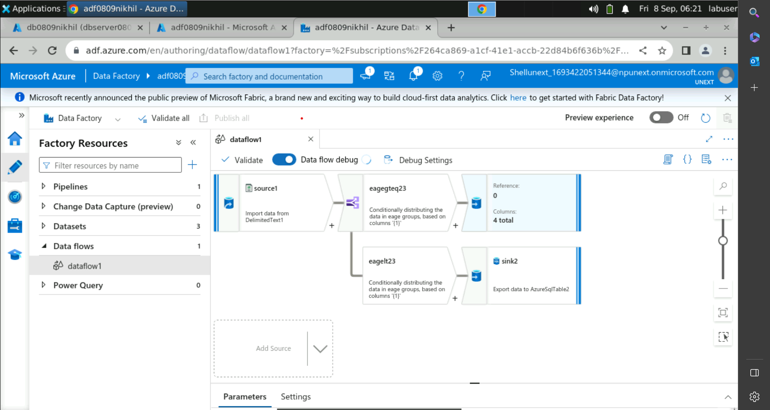
08-09-2023

Slide 18
08-09-2023
API Integration: Microservices and Application.
APIs allow application to build and use business logic, data and forms as a service.
Change Data Capture(CDC)
Azure Monitor: Provides a monitoring approach by collecting, analyzing and acting on telemetry from both cloud and on-prem environments.
Metric data
Logic data
Alerts

Slide 19
08-09-2023
Monitoring Network
Network Performance Monitor: Measures the performance and reachability of the networks that you have configured.
Application Gateway Analytics

Slide 20
08-09-2023
Connectivity Issue
Unable to connect to data platform
Authentication failures
Cosmos db Mongo db api errors
SQL database failover

